Slide 1
Using PSO to Optimize a GA for Image Reproduction
Bo Bleckel, Jasper Houston, Dylan Parsons
May 17, 2017

Slide 2

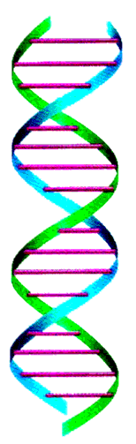
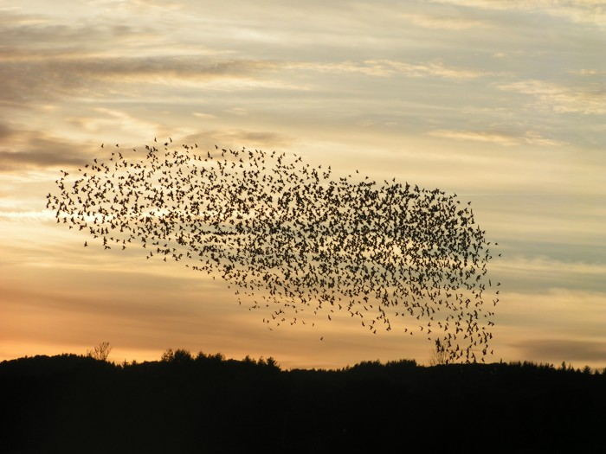
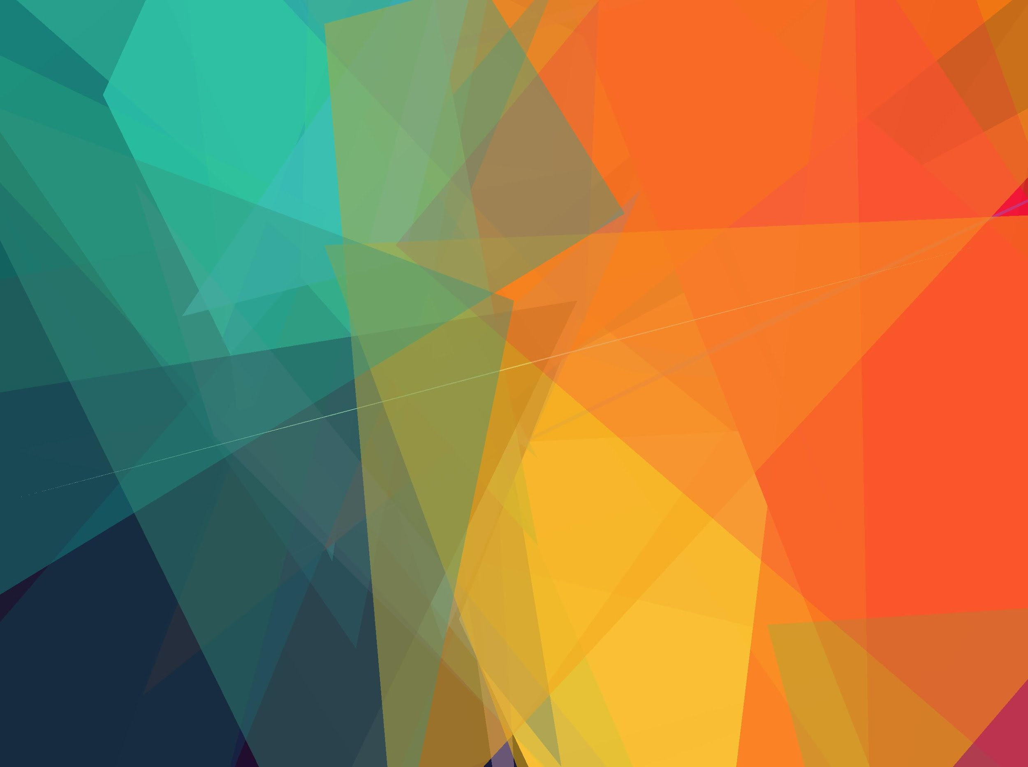
Notes:
Jasper

Slide 3
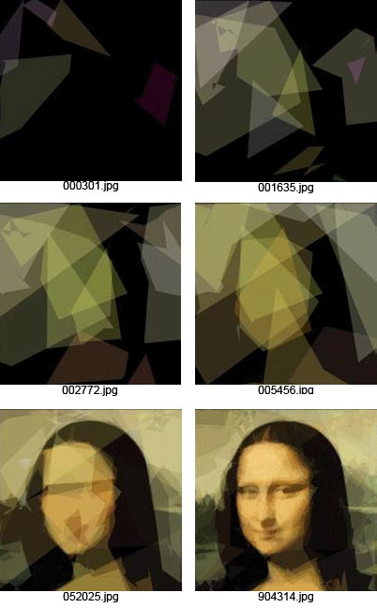
Problem: Image Re-Creation
Inspiration: Roger Alsing, Blogger
Chris Cummins - Grow Your Own Picture
Notes:
Jasper

Slide 4
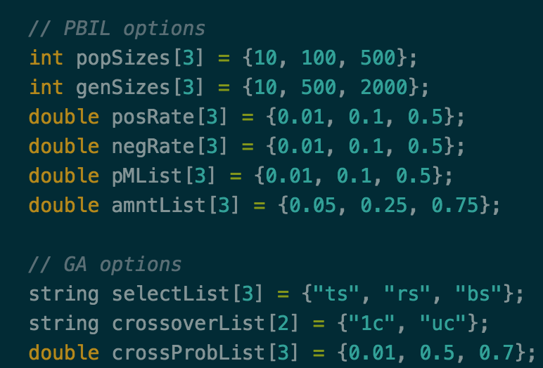
Problem: Parameter Optimization
Limitations of previous parameter testing
Wait! We’ve been looking at optimization all semester!
PSO for Parameter Optimization?
Notes:
Jasper

Slide 5
Approach: GA - How they do it
Quick Reminder:
GA works by evolving a population over a number of generations
Each individual in the population represents a candidate solution
Selection is applied
Recombination (crossover) is applied
Mutation is applied
We used GA to solve MAXSAT problems in Project 1.
Here we’re using it to recreate images using a limited number of polygons.
Notes:
BO

Slide 6
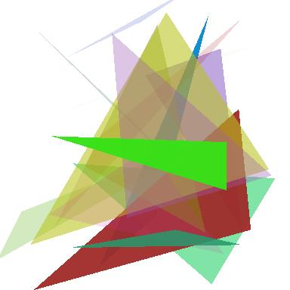
Approach: How GA Applies
Individual = collection of triangles forming an image
Fitness = pixel by pixel comparison, sum of color differences
Requires each individual to draw image each fitness call
Image resolution has huge impacts on runtime
Selection = Boltzmann
Crossover = Uniform
Mutation changes vertices, color, & alpha of triangles
Example random individual:
Introduce elitism
Save and re-insert best individual from the last generation (replacing current worst)
Ensure progress
Notes:
DYLAN -- Describe sample individual

Slide 7
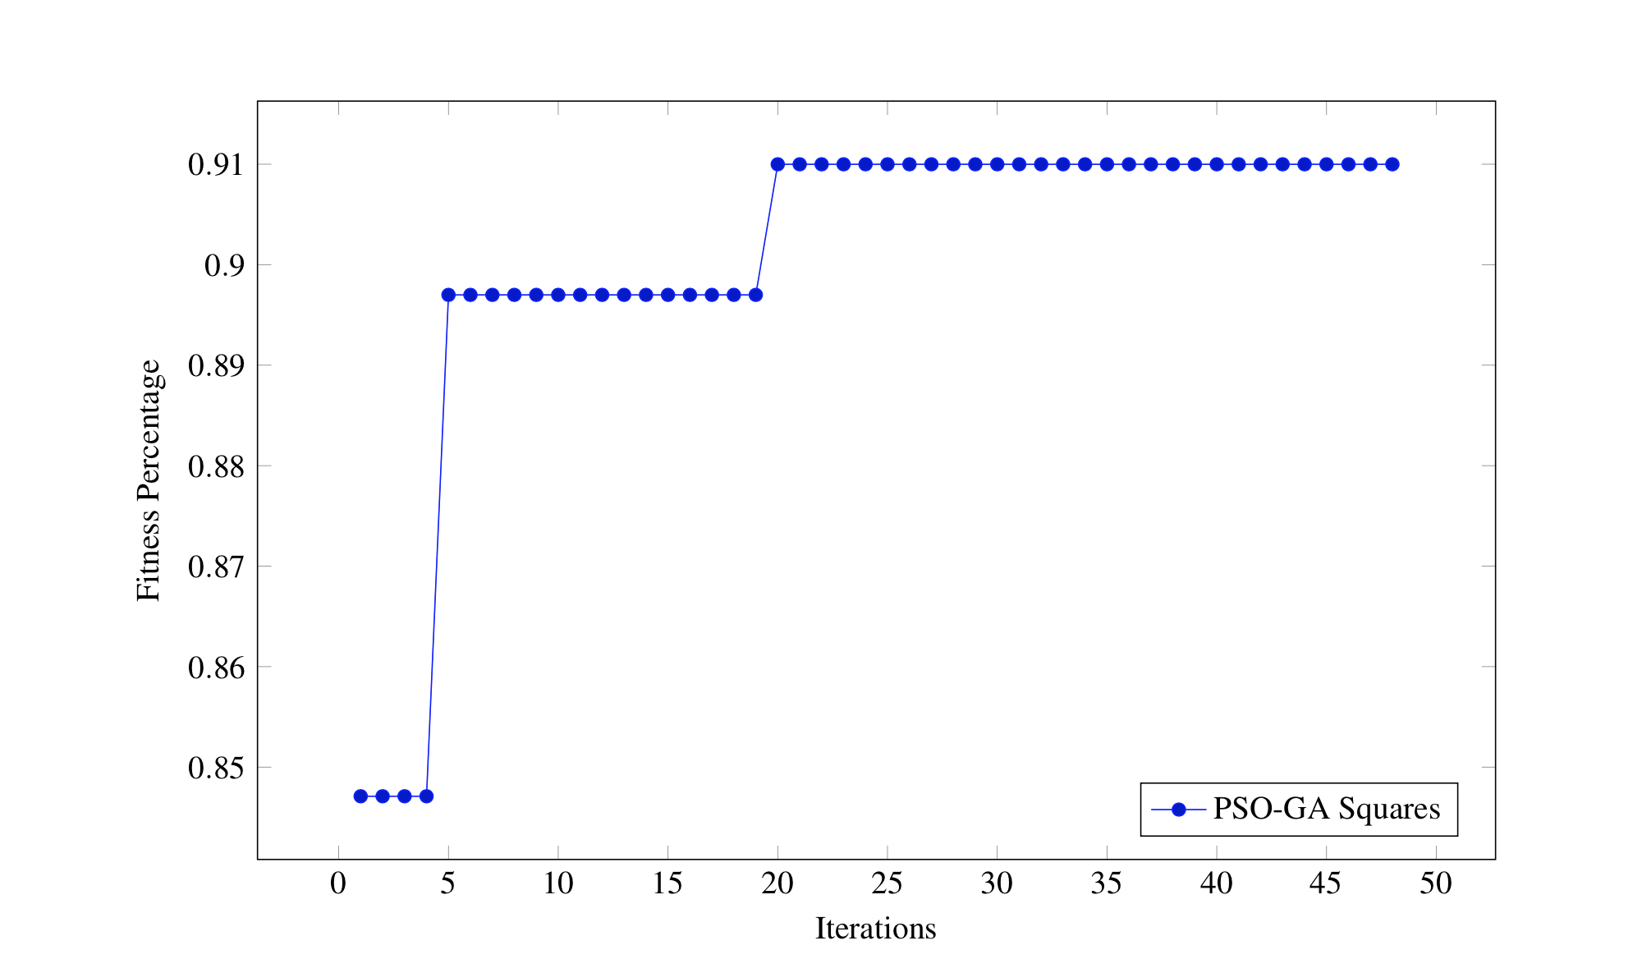
Approach: PSO
Code adapted from Project 2 to run on a GA
Positions and velocities in the solution space
Usually runs for 5,000-10,000 iterations with 15-50 particles
We ran it for 50 iterations with 10 particles
Usually optimizing a complex multidimensional function
We were optimizing 7 dimensions of parameters
Notes:
BO
Why we only ran it for 50 with 10 particles

Slide 8
Testing Methodology: PSO
Fix PSO parameters
10 particles
50 iterations
Random Neighborhood Topology
Optimize GA parameters, each parameter being a dimension in the particle’s position vector
Individuals
Number of triangles
Probability of crossover
Probability of mutation
Alpha/color/position mutation amount
GA was fixed to run for 1 minute instead of a number of a given number of generations
Tested on three images: 2 simple, 1 complex
Notes:
BO
Talk about how we restricted the values of each, and how we initialized the position in each dimension. Did the same, but manually, for GA alone.
The velocities were initialized uniformly over each dimension
Talk about sending the values to the GA and returning back from the GA

Slide 9
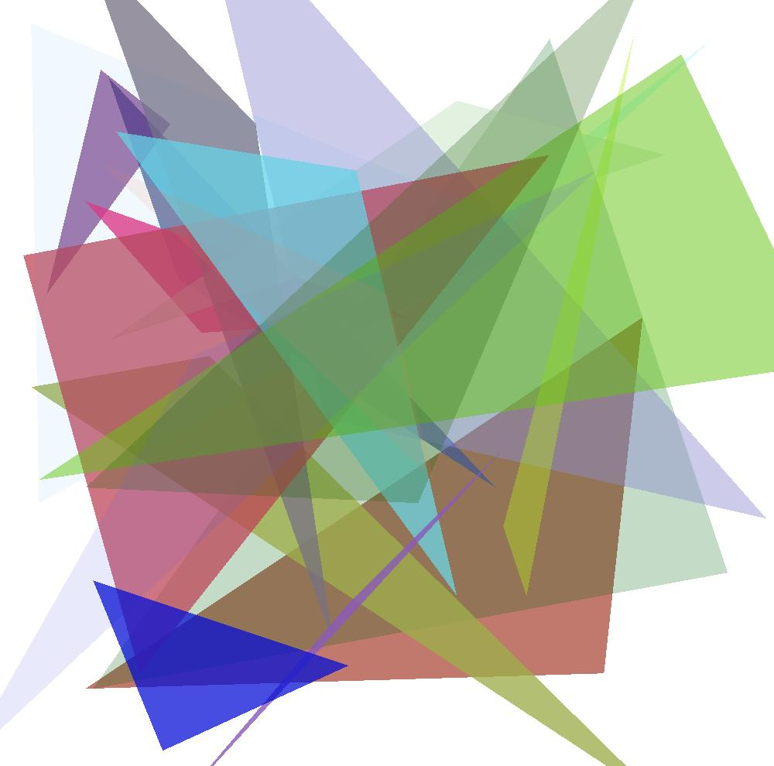

Results: GA
5 individuals
20 triangles
0.4 pC
0.1 pM
0.1 alpha mutation amount
19.8 point (x,y) mutation amount (20% of total)
15 color mutation amount
10,000 generations
Notes:
Jasper

Slide 10

Results: GA
5 individuals
20 triangles
0.4 pC
0.1 pM
0.1 alpha mutation amount
19.8 point (x,y) mutation amount (20% of total)
15 color mutation amount
10,000 generations
Notes:
Jasper

Slide 11
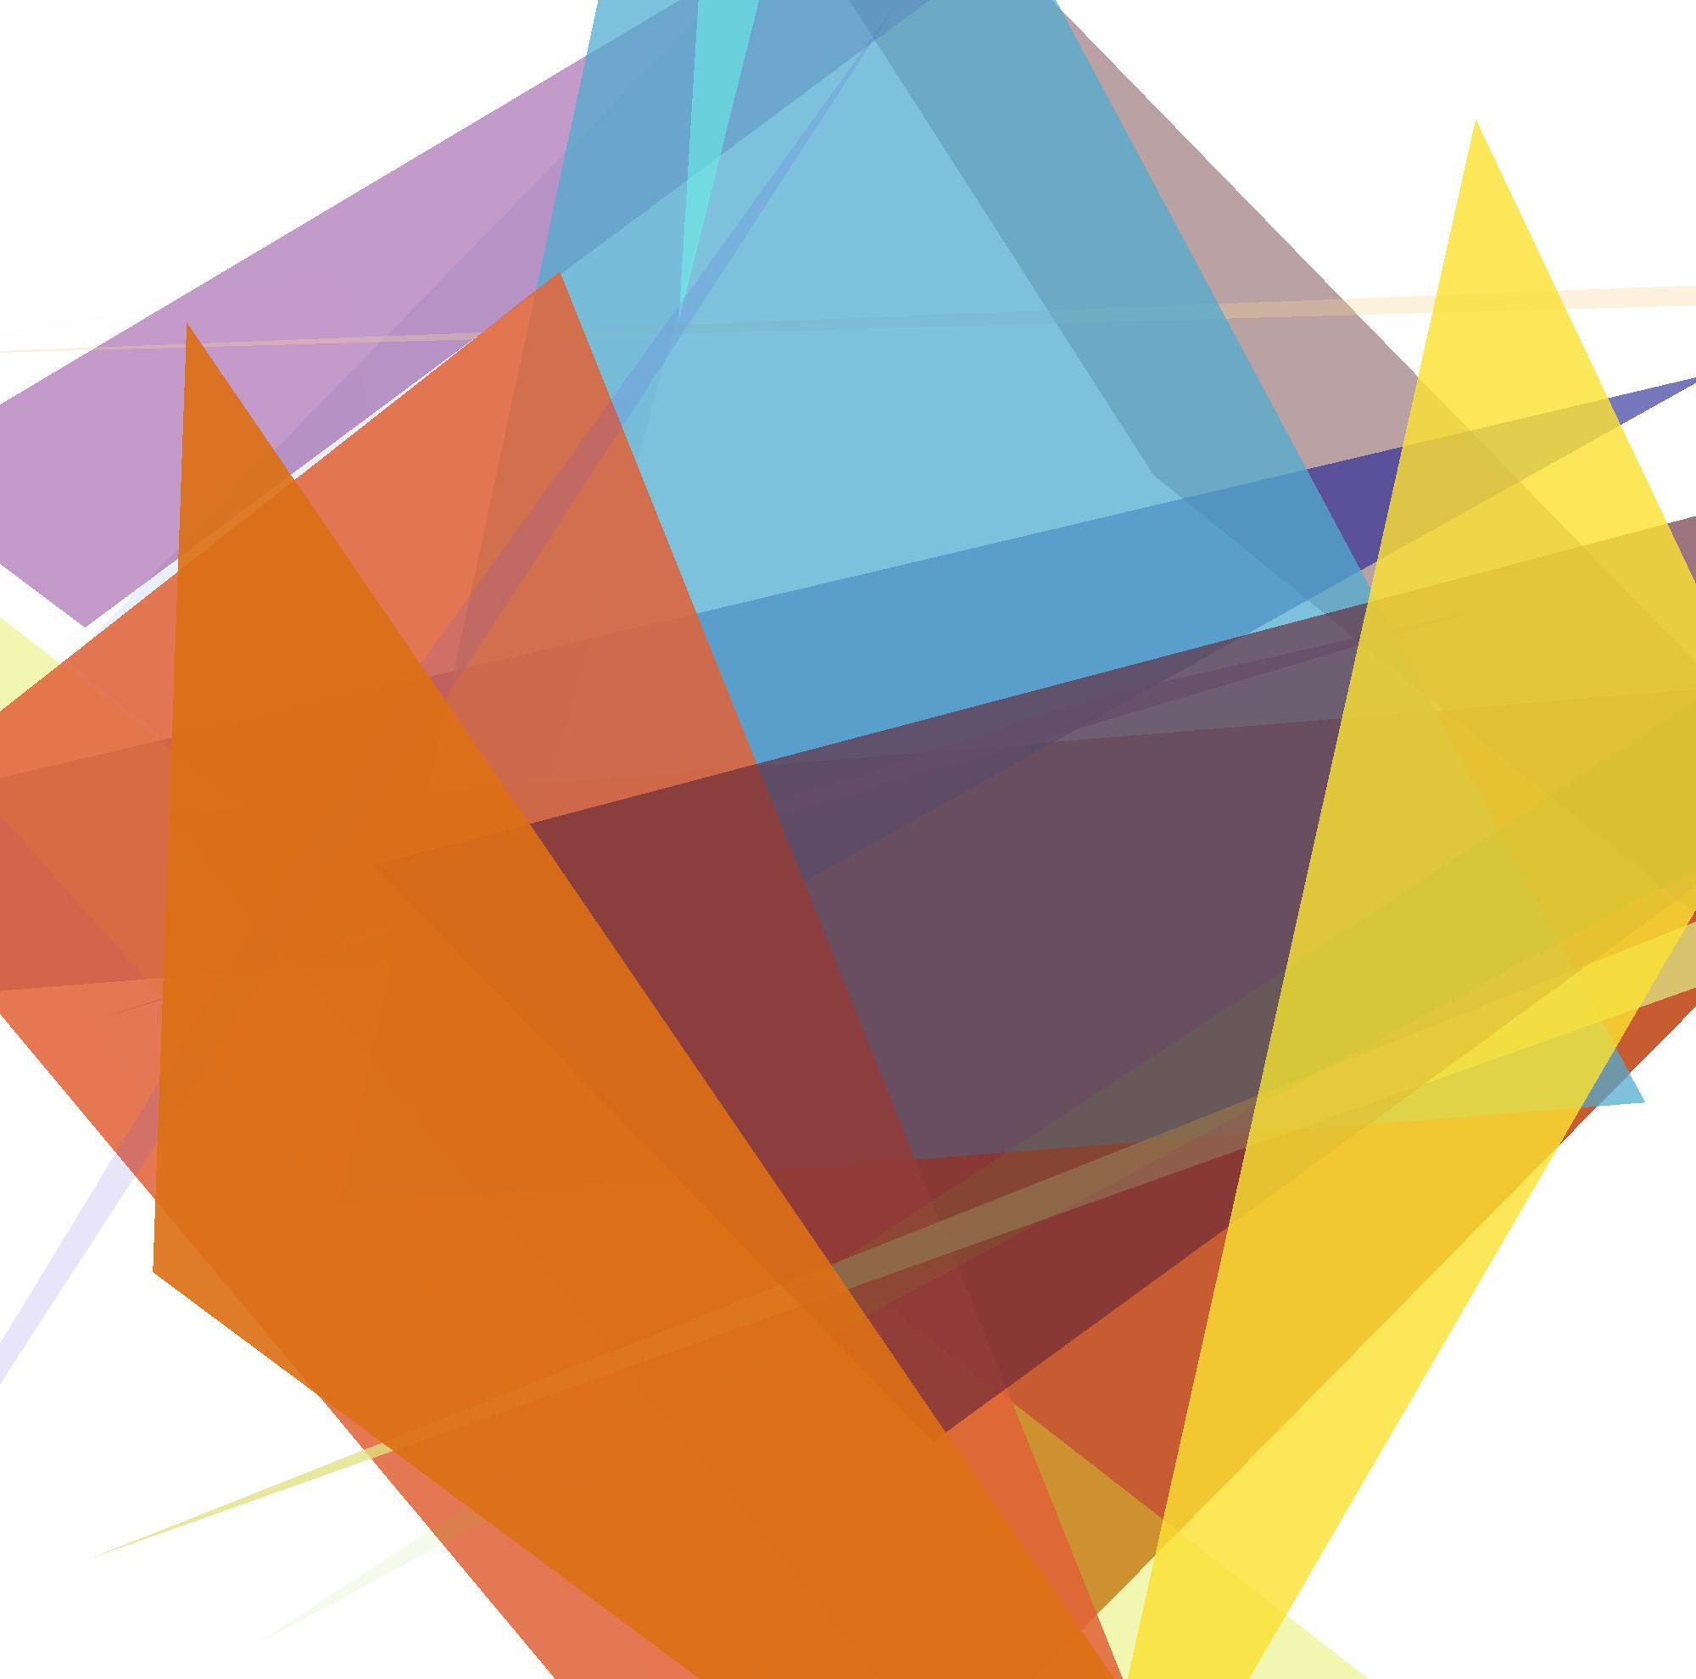
Results: GA
5 individuals
20 triangles
0.4 pC
0.1 pM
0.1 alpha mutation amount
19.8 point (x,y) mutation amount (20% of total)
15 color mutation amount
10,000 generations
Notes:
Jasper

Slide 12
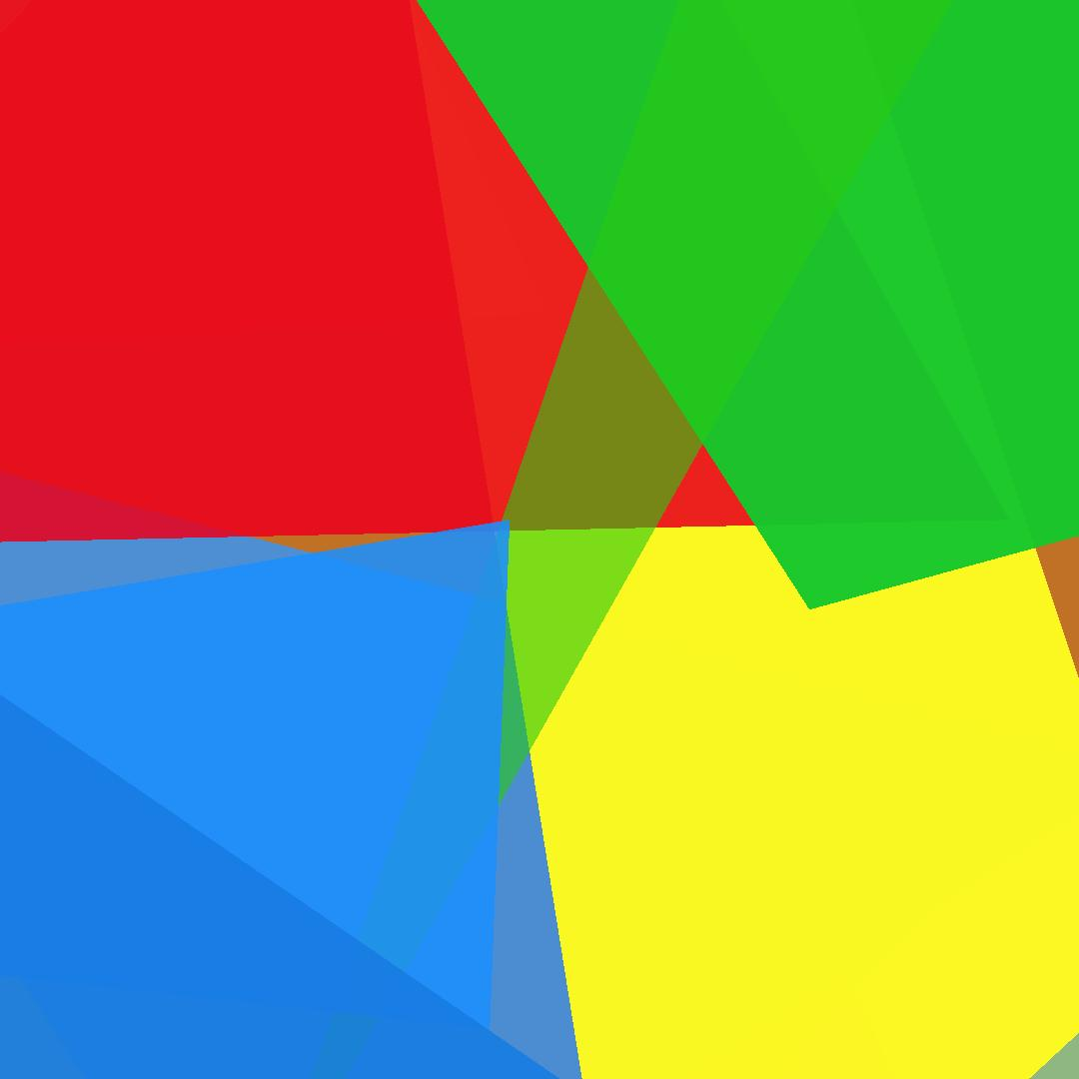
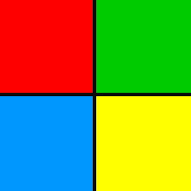
Results: PSO
Total 48 iterations of PSO with 10 particles using Random neighborhood topology
2 individuals
40 triangles
0.18 probability of crossover
0.09 probability of mutation
0.04 alpha mutation
5.46 point (x,y) mutation
27 color mutation
4087 generations
Fitness: 91.9%
Notes:
BO

Slide 13


Results: PSO
Total 17 iterations of PSO with 10 particles using Random neighborhood topology
9 individuals
15 triangles
0.23 probability of crossover
0.08 probability of mutation
0.17 alpha mutation
16.79 point (x,y) mutation
18 color mutation
4380 generations
Fitness: 95.1%
Notes:
BO

Slide 14
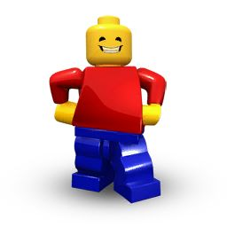
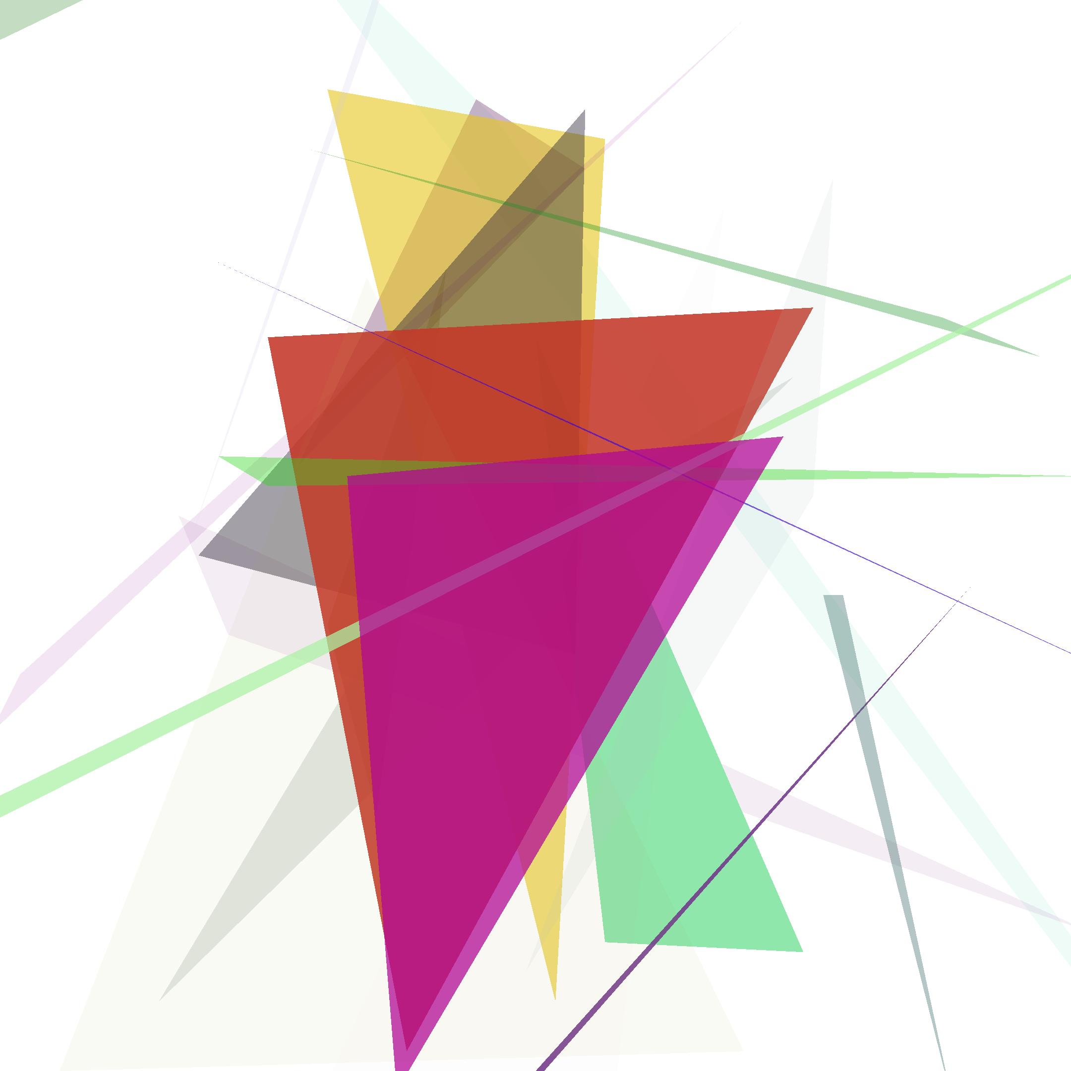
Questionable Results: GA
Notes:
DYLAN -- Triangles get smaller outside

Slide 15

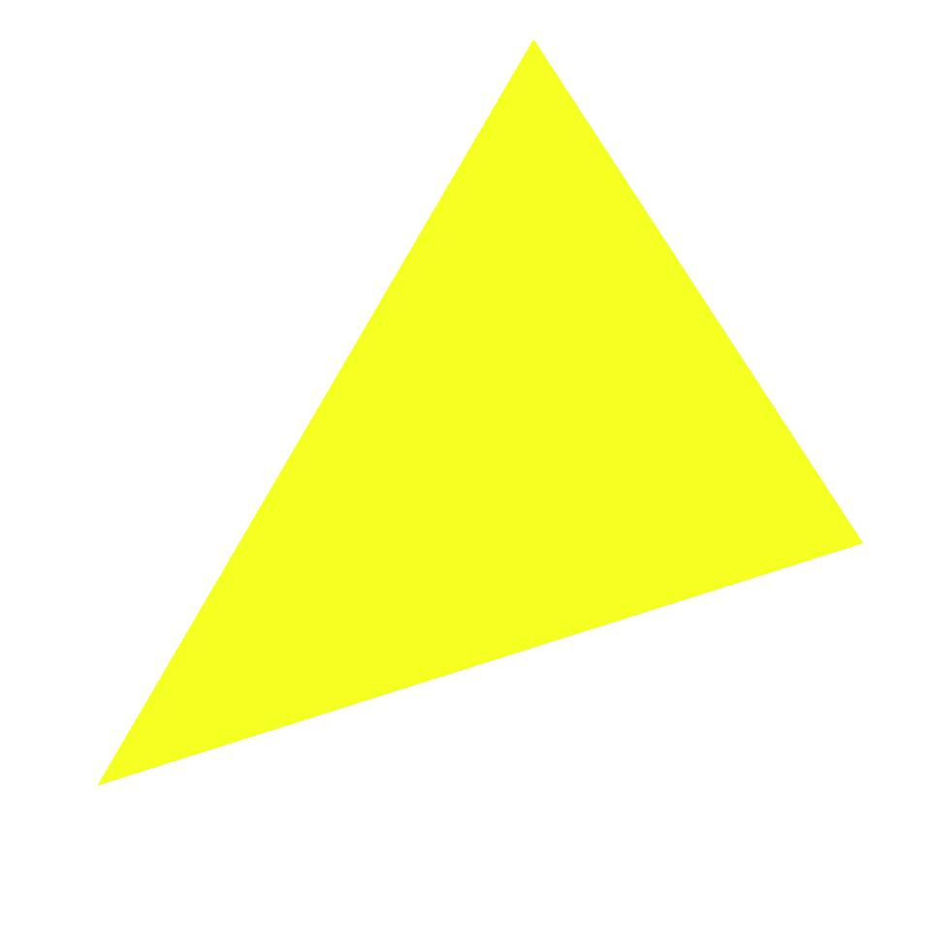
Questionable Results: GA
Notes:
DYLAN -- oversimplification -- the triangles disappeared here, will likely never return to help

Slide 16

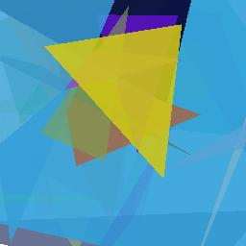
Questionable Results: GA
Notes:
DYLAN - too few triangles? Triangles get stuck in their spot and don’t move

Slide 17

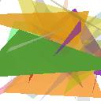
Questionable Results: GA
Notes:
DYLAN -- alpha values are set high, like for green. Then triangles below don’t evolve well, because they don’t contribute to the image. The alpha will never decrease, then, because it would decrease the fitness, so the triangles never improve, so… etc.

Slide 18
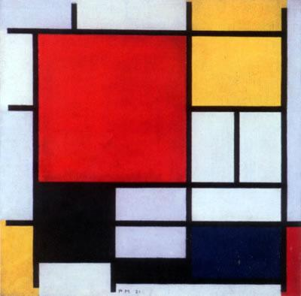
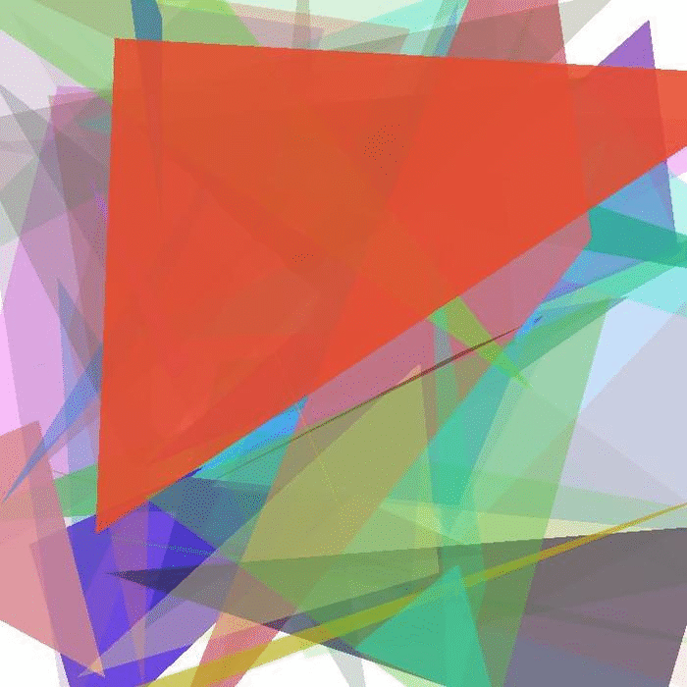
GA: Convergence
50 Individuals
50 Triangles
5000 Iterations
1 hour runtime
Notes:
DYLAN -- Populations can converge, unable to sustain improvement through genetic combination. Mutation is also too unreliable to produce improvements, so the population stagnates.

Slide 19
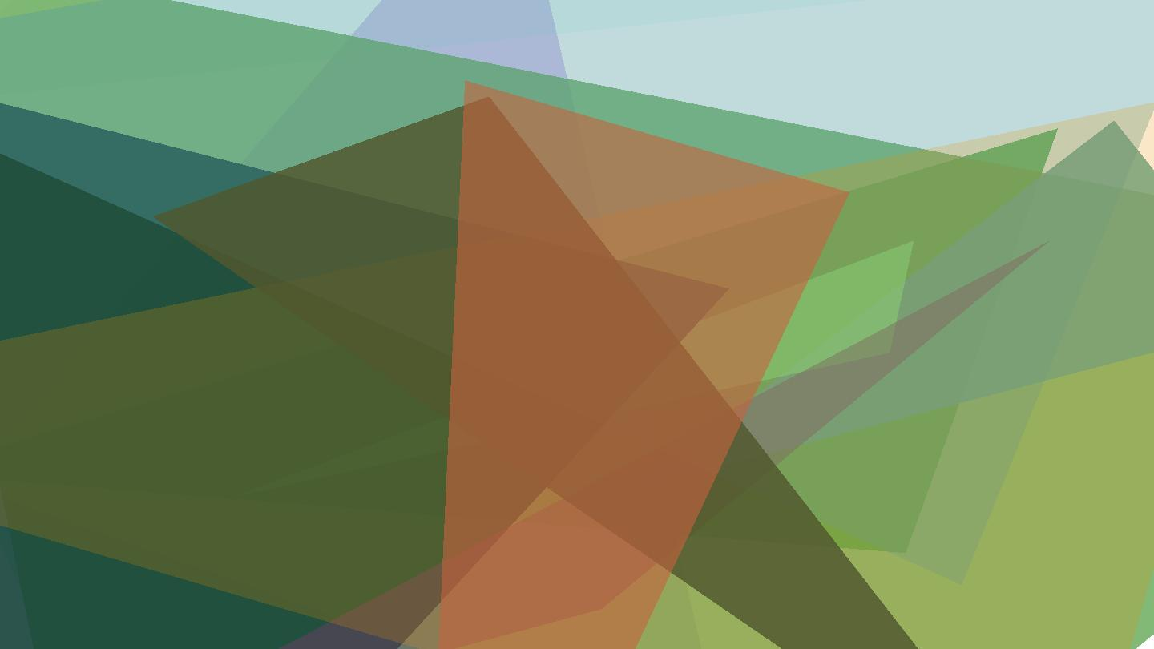
Questionable Results: PSO
Total 6 iterations of PSO with 10 particles using Random neighborhoods
18 individuals
13 triangles
0.16 probability of crossover
0.11 probability of mutation
0.34 alpha mutation
51.66 point (x,y) mutation
44 color mutation
911 generations
Fitness: 88.04%
Notes:
BO

Slide 20
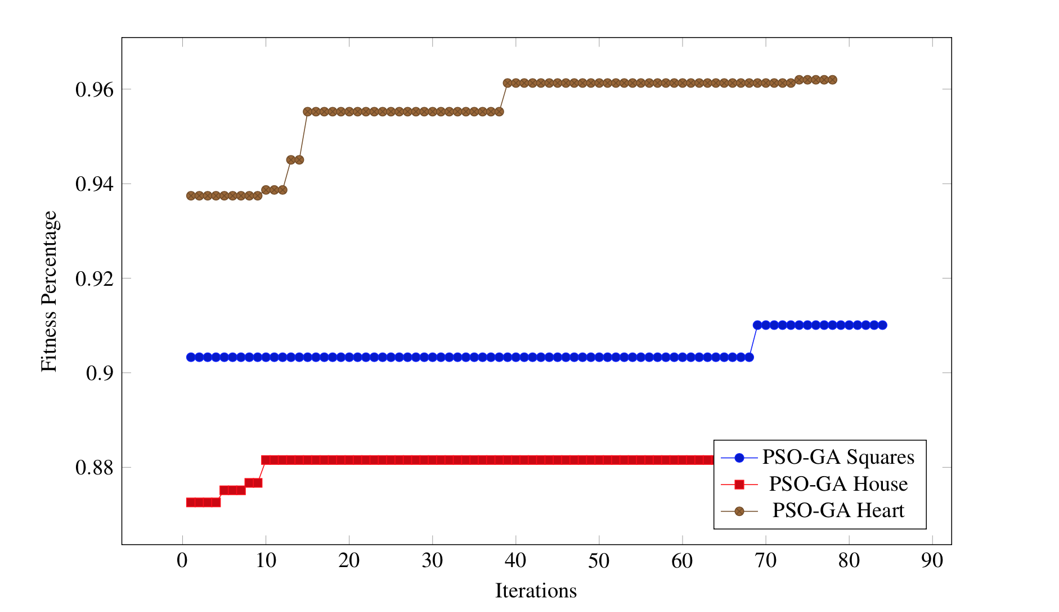
Results: PSO
Notes:
BO

Slide 21
Future Work
Polygons beyond triangles - more appropriate for some images
Refine algorithm
Speed problems - how to solve this
Advanced initialization tactics
Notes:
Jasper

Slide 22
Summary and Conclusions
Using triangles to recreate images is not the most effective method for image re-creation
We were able to accurately, to some effect, recreate high contrast images with simple shapes; however, we struggled with more complex images
The speed of the algorithm is an issue
Limited our ability to fully test the effectiveness of PSO
The pictures are pretty though!

Slide 23
